Slide 1
COMMON-WEARS TESTBED FOR IN-DOOR ACTIVITY DETECTION AND RECOGNITION
Qimeng Li, Ph.D.
University of Calabria, DIMES

Slide 2
OUTLINE
Architecture for Activity Detection and Recognition
Testbed
Case Study

Slide 3
ARCHITECTURE FOR MAR
The proposed human-centric BSN-enabled architecture, whose high-level schema is depicted in left Figure, provides useful features and information by implementing distributed collaborative BSNs and exploiting smart environments, edge computing, and cloud services.
Fig. A hierarchical structure for recognizing multi-user activities.
Fig. The phases of multi-user detection process.
Notes:
The proposed human-centric BSN-enabled architecture, whose simplified architecture is depicted in Figure 1, provides useful features and information by implementing distributed CBSNs and exploiting smart environments, edge computing, and cloud services. Such systems are characterized by the use of software components with heterogeneous physical devices and protocols, so as to recognize multi-users activities and/or to provide final users with high-level services.
As we see from the right figure,
1) Neighbor Detection: it detects neighbor CBSNs among co-located people in a specific range.
2) Sensor Selection and Service activation: when neighbors have been detected, all of BSNs will activate/ select sensing on their own nodes and necessary (processing) services will be activated. This step will allow the system saving energy which means sensor will only activated when it is needed.
3) Potential Activity: once a one-sided potential activity occurs on a BSN, the corresponding BS will be notified.
4) Advertisement: the coordinator will send a message to all neighbor CBSNs to request if there is a corresponding reaction for detecting multi-user activity.
5) Collaborative Information Fusion: low-level data and recognized individual activity will be sent to BodyEdge; the edge layer will perform decision-level fusion according to specific classification algorithms to detect the multi-user activity.
6) Remote Access: if large amounts of data are needed for computation or storage, the BodyCloud layer will provide proper support. (Long-term analysis.)

Slide 4
ARCHITECTURE FOR MAR
Fig. A Collaborative Body Sensor Network
Fig. Architecture of CBSN.
BSN is composed of a base station (BS) (also called personal coordinator) with a set of wearable sensors (WSs).
The BS and WSs will transmit data through a single-hop communication protocol (e.g., Bluetooth, ANT+, Zigbee) due to the characteristics of BSN.
CBSNs are specific BSNs with cooperative behavior providing co-located users with collaborative and distributed application services. The CBSN reference architecture is shown in right Figure.
Notes:
We see a collaborative Body Sensor Network structure
which sensors are usually arranged on the body, with close physical distance, so data do not need to be transmitted to a sink node or BS through other sensors.

Slide 5
ARCHITECTURE FOR MAR
Fig. Architecture of BodyEdge Gateway.
The BodyEdge Gateway (BEG) can be combined in the proposed architecture as an intermediate layer to connect CBSNs and BodyCloud for facilitating MAR.
Fig. Architecture of Cloud.
The Body Cloud is used for long-term monitoring and historical and statistical analysis and remote data access or system control.
Notes:
The edge computing paradigm moves part of application logic, data, and computing power (services) from the core to the network’s boundary to meet the location-aware data processing, energy conservation, and data privacy requirements. It reduced transmission cost and network delay between users and servers to a certain extent. The edge devices vary from a low-power single-chip computer to a powerful server. BodyEdge [21] is a specific edge-based architecture well designed to support emerging applications for the healthcare industry.
The abstractions of the Cloud-side are supported by a RESTful web service, implemented using the Restlet Framework, making the interaction with the Cloud-side HTTP based. In our design, we selected the BC as an optional component at the Cloud layer, which comes into play essentially in just two cases: 1 when the user needs long-term monitoring and historical and statistical analysis; 2 when some external users and administrators need to remotely access data or control the system.

Slide 6
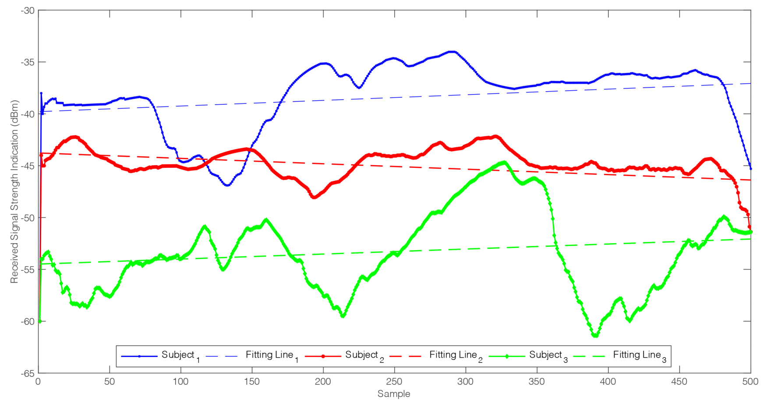
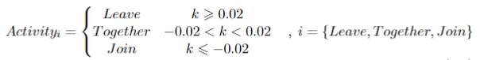
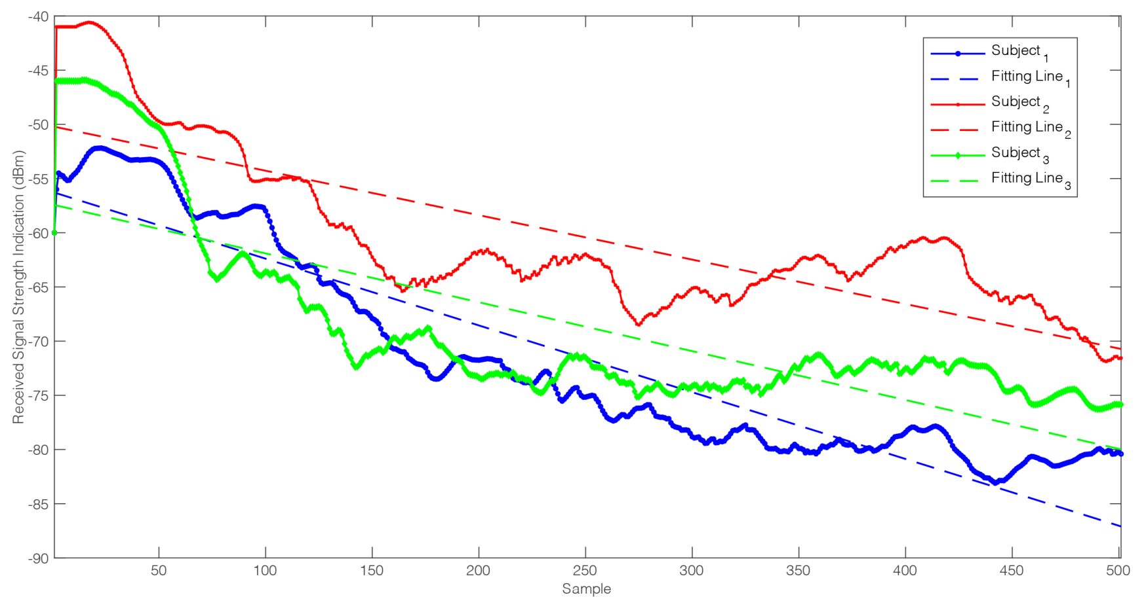
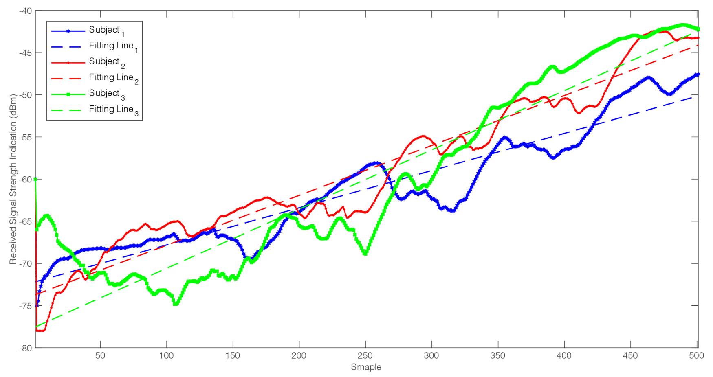
ARCHITECTURE FOR MAR
Proximity-driven Group Structure Analysis
Feasibility Analysis of using Proximity Information
We analyzed the correlation between proximity and MAR and the role of proximity in distinguishing different MA.
we can observe that the trend of these three kinds of activities are different. Therefore, the slope of RSSI curves can be used to distinguish different activities.
‘Together’ event
‘Leave’ event
‘Join’ event
Notes:
The edge computing paradigm moves part of application logic, data, and computing power (services) from the core to the network’s boundary to meet the location-aware data processing, energy conservation, and data privacy requirements. It reduced transmission cost and network delay between users and servers to a certain extent. The edge devices vary from a low-power single-chip computer to a powerful server. BodyEdge [21] is a specific edge-based architecture well designed to support emerging applications for the healthcare industry.
The abstractions of the Cloud-side are supported by a RESTful web service, implemented using the Restlet Framework, making the interaction with the Cloud-side HTTP based. In our design, we selected the BC as an optional component at the Cloud layer, which comes into play essentially in just two cases: 1 when the user needs long-term monitoring and historical and statistical analysis; 2 when some external users and administrators need to remotely access data or control the system.

Slide 7
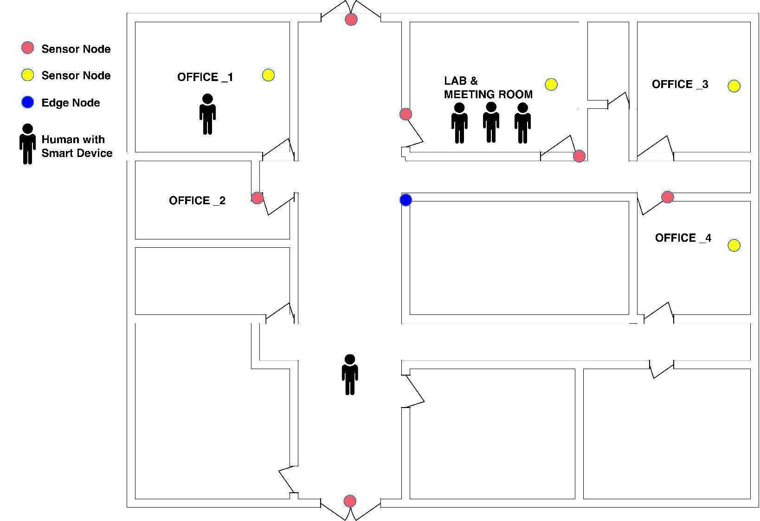
TESTBED

Slide 8
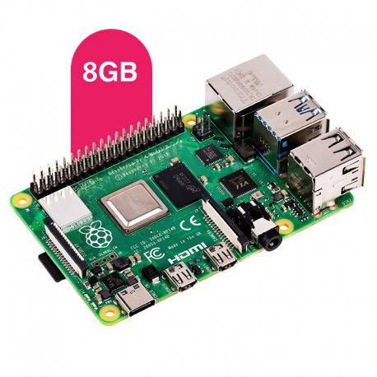
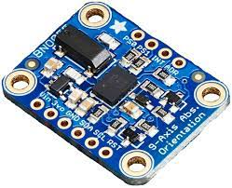
TESTBED
Raspberry Pi 4
BNO055 9-DOF IMU breakout
The BNO055 can output the following sensor data:
Absolute Orientation (Euler Vector, 100Hz) Three axis orientation data based on a 360° sphere
Absolute Orientation (Quaternion, 100Hz) Four point quaternion output for more accurate data manipulation
Angular Velocity Vector (100Hz) Three axis of 'rotation speed' in rad/s
Acceleration Vector (100Hz) Three axis of acceleration (gravity + linear motion) in m/s^2
Magnetic Field Strength Vector (20Hz) Three axis of magnetic field sensing in micro Tesla (uT)
Linear Acceleration Vector (100Hz) Three axis of linear acceleration data (acceleration minus gravity) in m/s^2
Gravity Vector (100Hz) Three axis of gravitational acceleration (minus any movement) in m/s^2
Temperature (1Hz) Ambient temperature in degrees celsius
Single-board computer, can be used as edge devices.

Slide 9
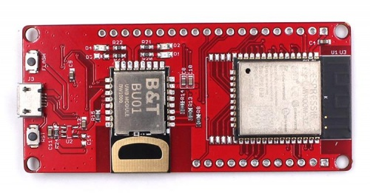
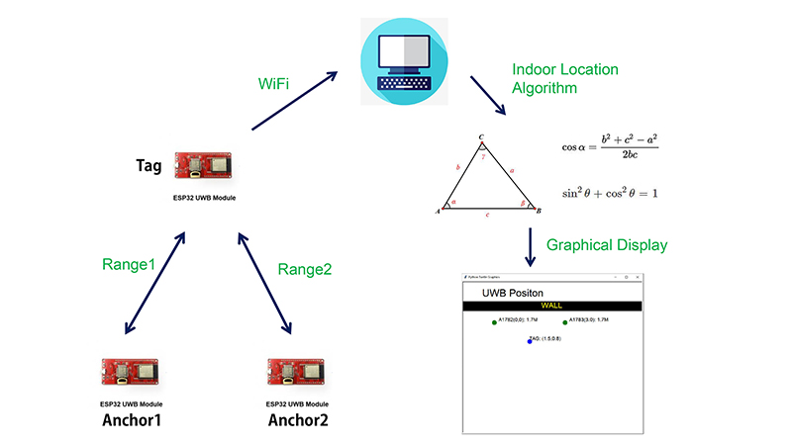
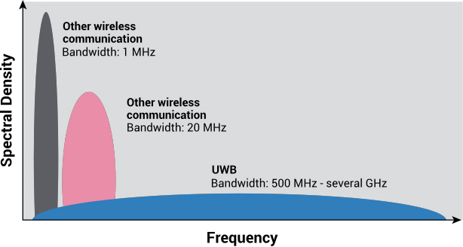
TESTBED
ESP32 UWB

Slide 10
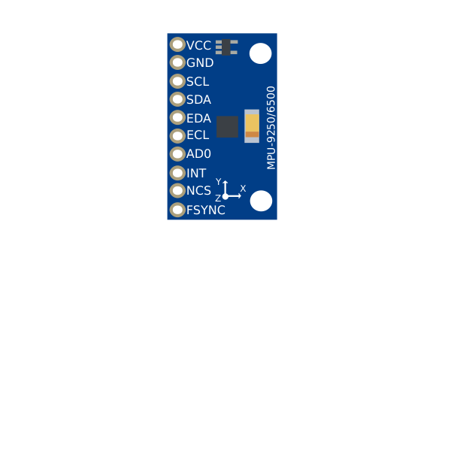
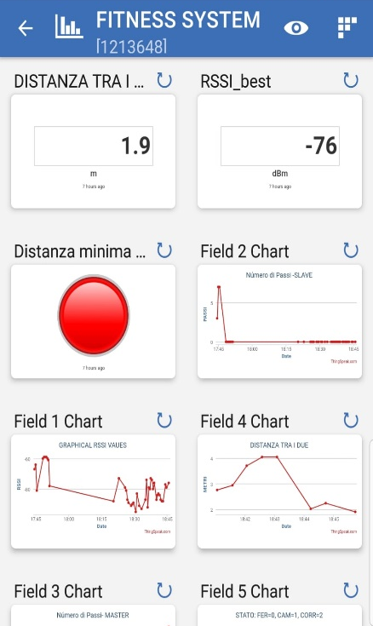
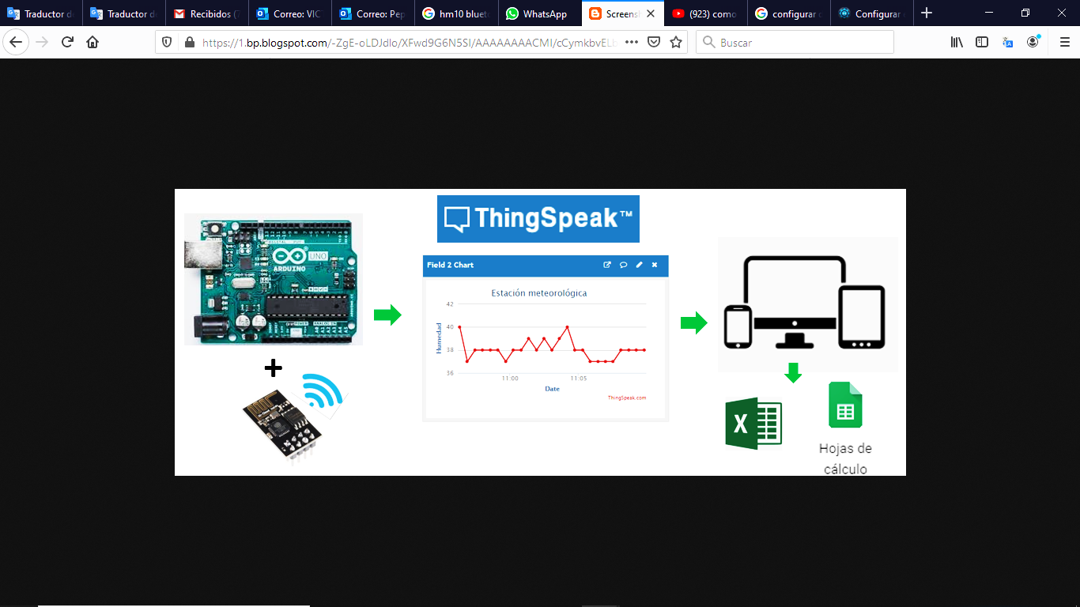
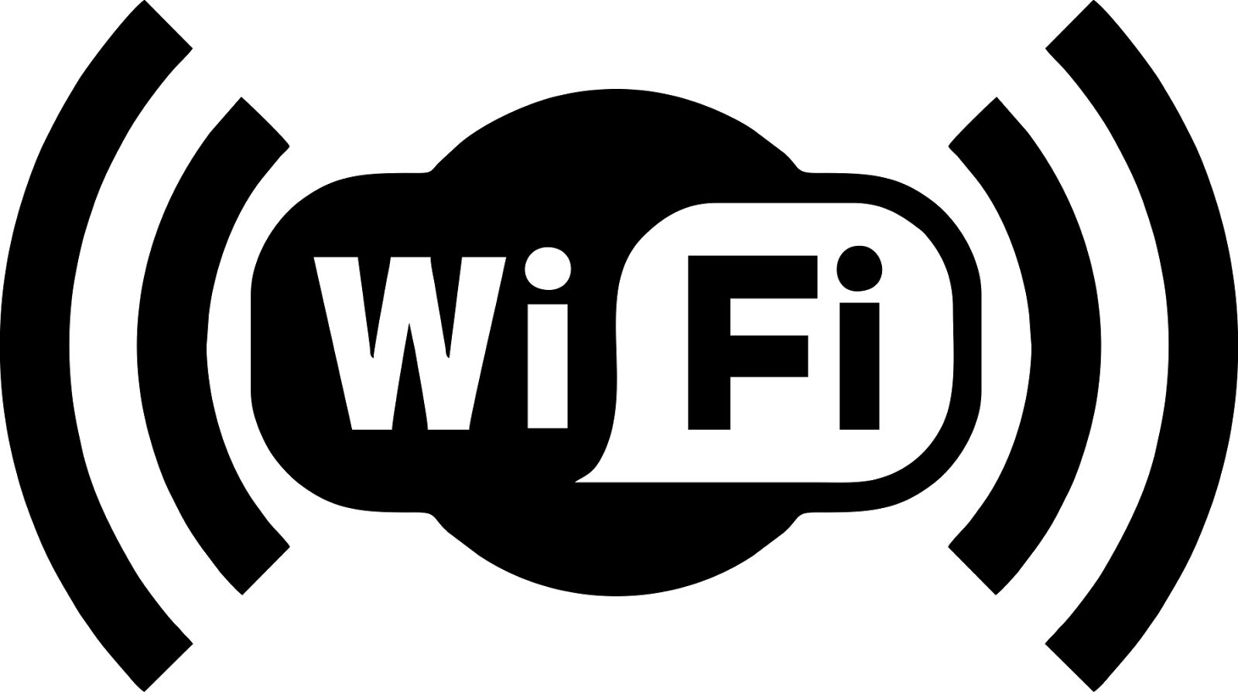
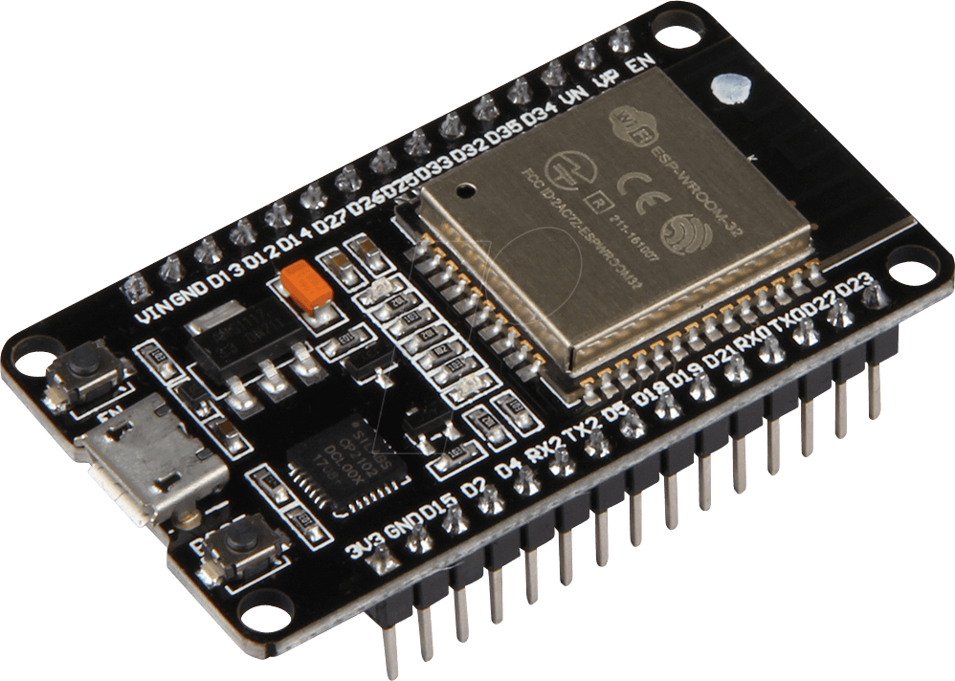

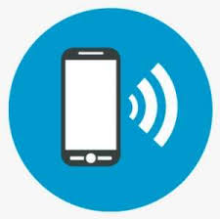
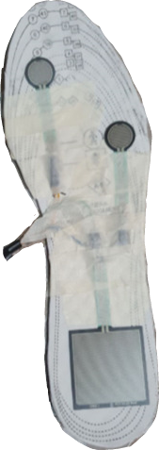
USE-CASE 1 For COVID-19
For understand social activity and social distance
IMU
Your Picture Here
MICROCONTRALLORE
3 SENSORI FSR

Slide 11
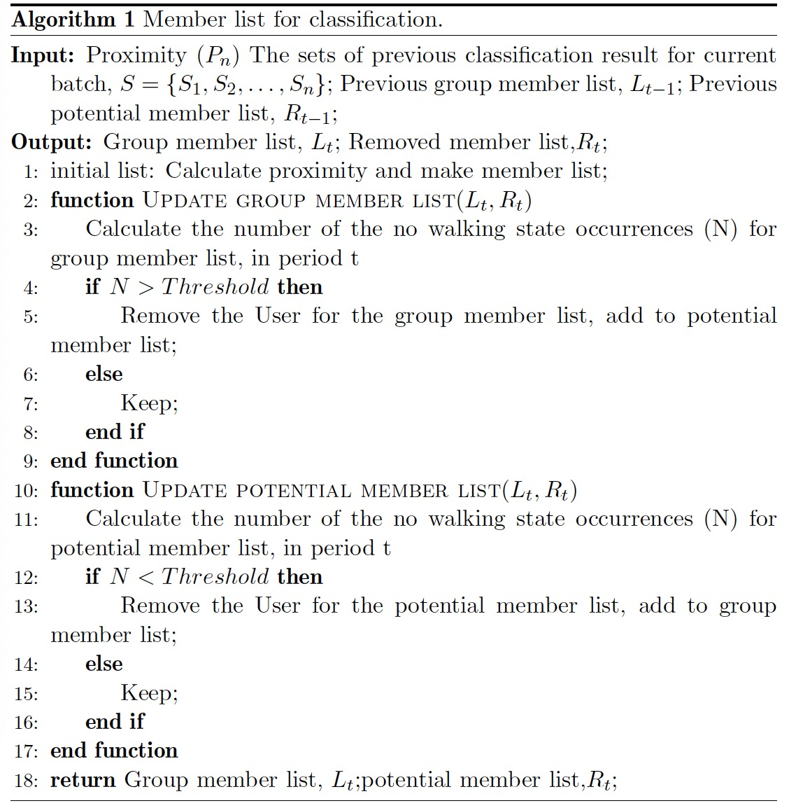
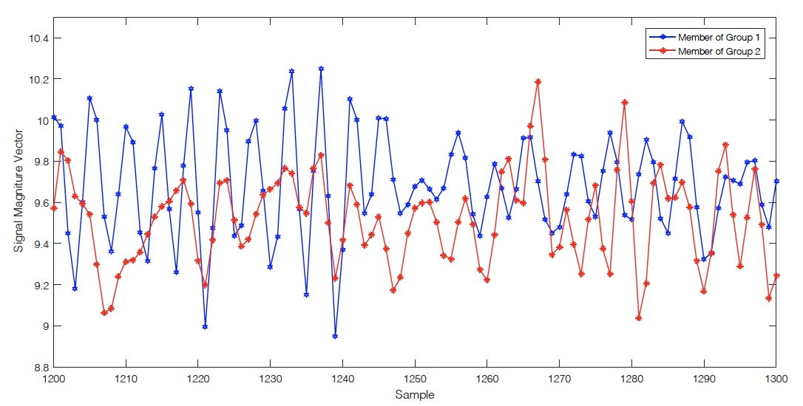
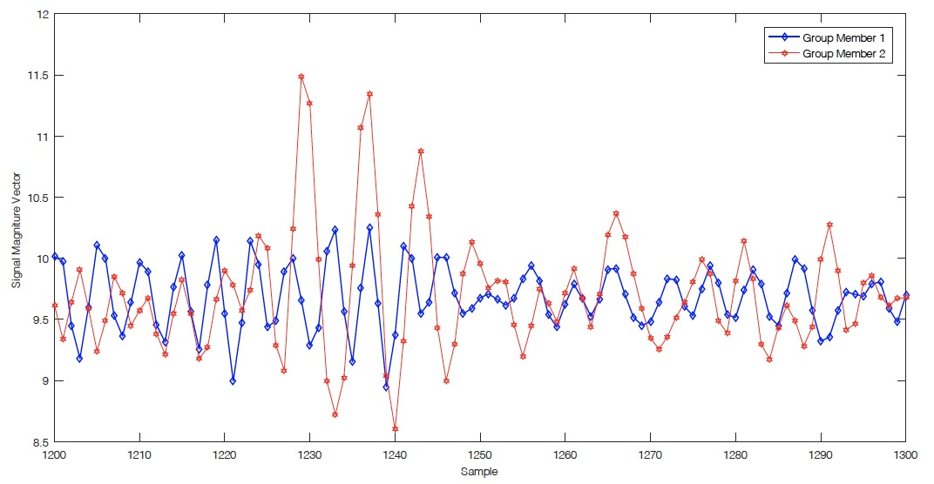
USE-CASE 2 GROUP WALKING RECOGNITION
data from different groups
data from same group
Notes:
As shown in Figure, users from the same group often accelerated or decelerated in the same pattern; and in Figure, the pattern in some areas is different due to the participants are in a different accelerative situation. Still, all of the above can not indicate that users have a similar pattern just from the same group; their motion pattern could also be similar between different groups. Human motion patterns are usually random, and different groups of people may have the same motion pattern at the same time. Besides, human activities are usually very subjective, and individual consciousness may lead to inconsistent actions simultaneously, resulting in different motion patterns for people in the same group.
Thus, the acceleration data only can be used in recognizing the motion state (e.g., walking, standing) of the participant.

Slide 12
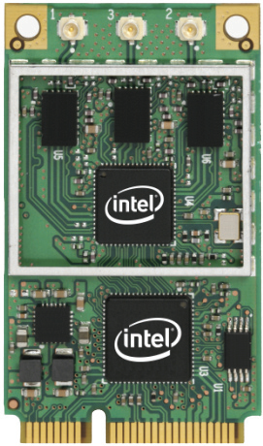
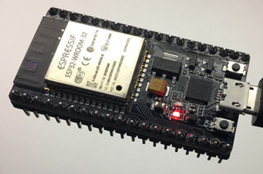
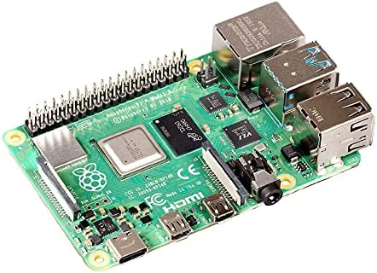
USE-CASE 3
Recent advancements on Wi-Fi signal analysis suggest that this pervasive communication infrastructure can also represent a convenient, non-invasive contact-less sensing method to detect human activities.

Slide 13
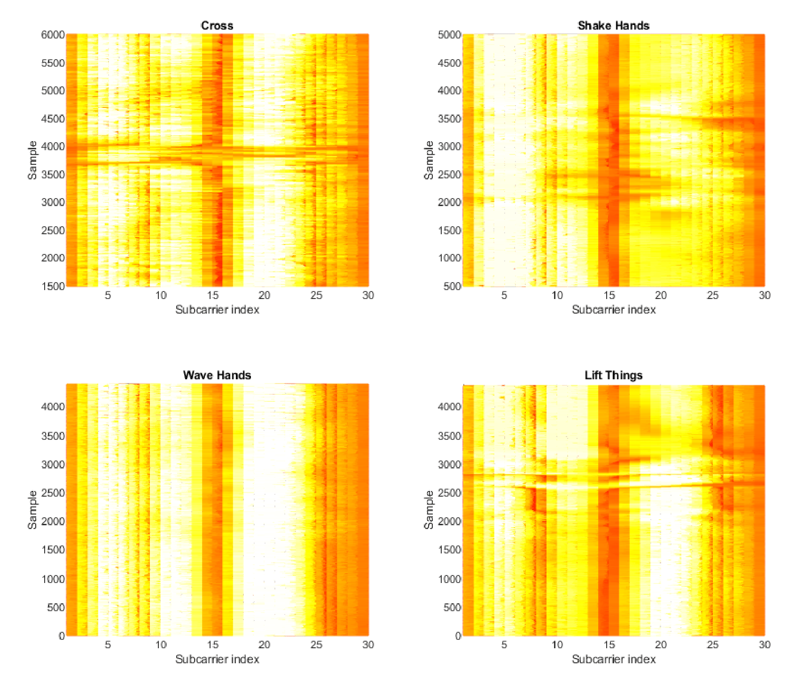
USE-CASE 3
Wi-Fi Channel State Information (CSI) analysis to recognize
social activities (e.g. walking together)
gestures (e.g. hand-shaking)

Slide 14
Thanks! Q?A!

